Slide 1



Notes:
Hello, my name is Dylan Karman, professional data scientist and you (Eli) have approached me about identifying the different variables that are associated with the sales price of a house.

Slide 2
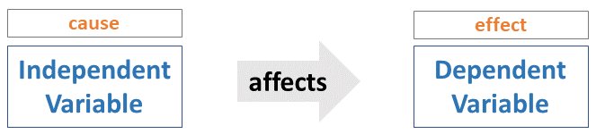
Problem Statement
What are the variables that influence the sales price of a house in King County, USA?
???
Sales Price
Notes:
In order for us to be able to accurately predict future housing prices in KC County, we must first ask ourselves,
What are the variables that influence the sales price of a house in King County, USA?

Slide 3

Business Value
  With this information we can gather the variables that contribute positively to the price of a house, and predict future housing prices, saving/earning your business time and money!
???
Sales Price
Notes:
With this information we can gather the most important variables that contribute positively to the price of a house, and predict future housing prices, saving you time and money!

Slide 4

Methodology
  The Data Set included variables from different houses in the area:
    No. of Bathrooms
    No. of Bedrooms
    Price
    Sq ft. House
    Sq ft. Lot
    Longitude
    Latitude
    Etc.
Notes:
The Data Set that was provided to me about the housing market in King County, contained many variables you might consider towards the sales price of a house such as bathrooms and bedrooms. However, the data set also included things such as latitude and longitude which I would not have thought to be relevant. Do these variables contribute to or diminish from the sales price of a house? Let us find out.

Slide 5

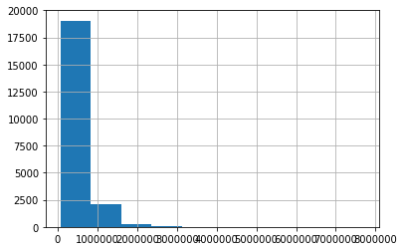
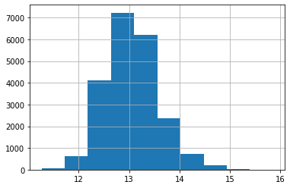
Methodology
Price (regular)
Price (normalized)
Notes:
Because the data is not all on the same scale, ie., price in dollars of house compared to sq. ft., etc., the data needs to be normalized so that the model we are making can make sense of all of the data. The pricing data of the houses shown is a great visual of this happening. We will repeat this process for all of the data points that do not show a normal distribution.

Slide 6
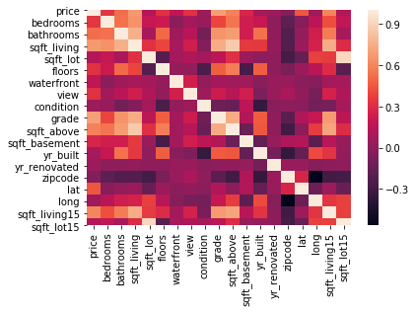
Heat Map/Correlations
Methodology
Notes:
As you can see from looking at this heat map, we have set price as the target variable. The very far left column in this heat map are the correlations between the price and the other variables. The more white the tile is the more correlated those two variables are.

Slide 7
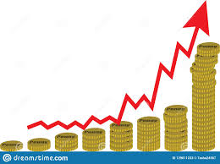
Findings
All of the variables in the data set positively affect the price.
After running the model, I can predict the housing prices in KC with 77% accuracy.
Notes:
After looking over the data set, I have determined that all of the variables within the data set are positively correlated to the target variable. I can accurately predict housing prices in King County, USA, with a 77% threshold.

Slide 8
Future Work
If I had more time with this data, I would:
  Gather more variables
  Drop more columns
  Normalize the data more
  Check other cities housing markets to see if there are trends
Notes:
If I had more time with this data, I would: Gather more variables, Drop more columns, Normalize the data more, Check other cities housing markets to see if there are trends

Slide 9


Notes:
Thank you for your time and good luck!

